Slide 1
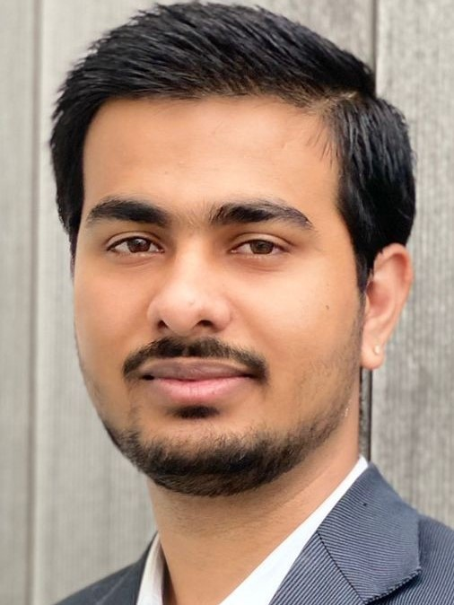
Abhishek Danalakota Technology Consultant
Mobile +353 12211452
Email abhishek.danalakota@ie.ey.com
Background
Professional Experience
Drive to meet or exceed daily performance metrics related to key performance indicators
He engaged with the operations and engineering managers to build, drive and improve our tools and processes
Security Delivery Specialist
Leading Tech Company
February 2018 – January 2019
Abhishek worked as IT security delivery specialist handling Australian clients and supporting them in maintaining their active directory and information security, providing infrastructural services to clients
He holds a strong knowledge and experience to manage IAM activities including ID administration, provisioning, governance/auditing, reporting, operations.
He also managed user life cycle and integrating application requirements in a shared services framework focused on provisioning, de-provisioning, entitlements and role-based access control
He was responsible for network monitoring and troubleshooting using appropriate tools
In-depth knowledge on client product and information security best practices
Provided access to new customers and stakeholder using Linux Servers
Abhishek was involved to investigate and troubleshoot issues and develop solutions for our customers while understanding their business needs
He is well versed in handling deadline and working under pressure even while the team leads moved to different projects
He gained strong knowledge on internal tools to monitor network, servers and application
Collaborating with internal and external stakeholders
Technology Consultant, EY large Irish bank
Abhishek assisted with the return-to-office protocols by provided tech support to users experiencing difficulties with their hardware.
Keep track of issues on a rolling basis and provided visualisations to clients using Microsoft Excel and PowerPoint
Documented all the processes for future references.
Developer Support Analyst Leading Tech Company
March 2020 – August 2021
Abhishek worked with various platform partners, managers and product owners, as a point of contact for developers, focusing on helping them build engaging and social applications using their platform.
Abhishek has experience with creation of Cyber Incident Response Plans by performing an analysis of the currently used architecture/processes and consolidating the information into a concise document with specifically marked details calling out the various steps of incident management.
Abhishek possess good knowledge of the incident management lifecycle and has experience with handling/ containing cyber incidents.
Abhishek has experience with creation and performing Table Top Exercises and creation of post exercise reports for highlighting gaps and reflect upon any fortifications, if needed.
Abhishek identified and evaluated risks based on the answers gathered in checklists and reported them to the respective application owners and the client.
He assisted developers with ClientAPI integrations using Graph API Explorer and troubleshooted production issue related to ClientAPIs and document the process
Abhishek is a Technology Consultant within the Digital & Emerging Technology competency of the Technology Consulting division within the EY Irish practice
Prior joining to EY, Abhishek has over 2.5 years of experience as Developer support, Technical support, and application support analyst with comprehensive work experience in the technology service sectors.
He has worked with Fortune 500 companies on their product and service based projects.
Abhishek holds a Master degree in Data Analytics from Dublin Business School and Bachelor of Technology in Computer Science, India where he achieved first class honours
Skills
Programming Language: Bash scripting, Python, JavaScript, PHP
Database: SQL, Oracle, MSSQL
Operating System: Windows, Linux - Ubuntu, CentOS, RedHat, Solaris
Web Application & Servers: Apache Tomcat, JBOSS, REST, CSS, HTML, APIs, SDK’s
Networking: LAN, WAN, IP, HTTP, DNS, TCP/IP, UDP, OSI model, Switching and routing
Server: Linux Servers, Windows 2008/2012/2016, UNIX
He has multiple industry certifications demonstrating his technology breath including:
Microsoft Azure Fundamental Certified(2021)
EY Microsoft Azure Learning Badge
ITIL v3 Certified
Lean six sigma trained and tested
Agile SCRUM Training

